Slide 1

Learning X2k: Parameter optimization via genetic algorithms to Calibrate the Expression2Kinases Pipeline
Brian M. Schilder¹, Alexander Lachmann¹, Maxim Kuleshov¹, Avi Ma’ayan¹
1. Big Data to Knowledge (BD2K) Library of Network-based Cellular Signatures (LINCS) Data Coordination and Integration Center (DCIC), Mount Sinai Center for Bioinformatics, Department of Pharmacological, Icahn School of Medicine at Mount Sinai, New York, NY

Slide 2
OUTLINE
Introduction
Background
X2K introduction
Previous results
Goals
Methods
Updated databases/parameters
ChEA (1, 2, 3)
G2N (1, 2, 3)
KEA (1, 2, 3)
How to determine which parameters/databases are best for consistently recovering kinase targets?
Validation
Genetic Algorithm (optimization method; explain steps)
GA Parameters used
Fitness: Defined as, percentage of correctly recovered kinase targets (using X validation database(s))
Results
This set of X2K pipeline databases/parameters work best
Insights as to why this is the case
Give real-world example with real gene set
Conclusions
It works
Future directions
References, Funding & Acknowledgements

Slide 3
Introduction

Slide 4
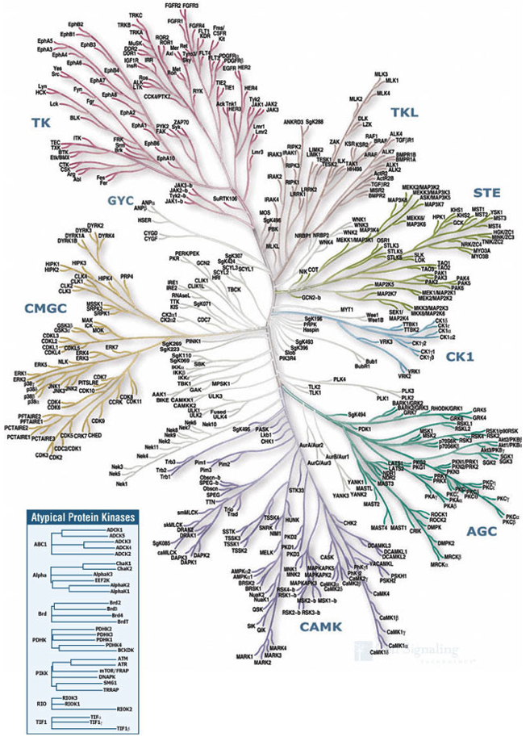
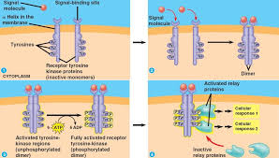
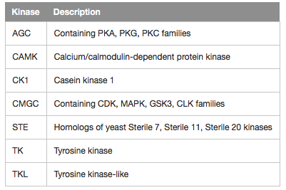
Background: Kinases
Evolution of the 7 main kinase groups
Introduction to kinases:
Enzymes that phosphorylate other proteins to regulate downstream molecular pathways.
e.g. Tyrosine kinase receptor transduction of signals from extracellular factors
Linked to the regulation of up to 30% of proteins in the human proteome.
Due to their regulatory role, kinases are promising targets for a number of diseases.
E.g. Dasatinib (kinase inhibitor) for cancer treatment
Recent kinase research:
Advances in the suppression of kinome reprogramming responses have further enhanced the translatability of kinase inhibitors in diseases like breast cancer (Stuhlmiller et al., 2017; Duncan et al., 2012).
Example: tyrosine kinase receptor
(Cell Signaling Technology)

Slide 5
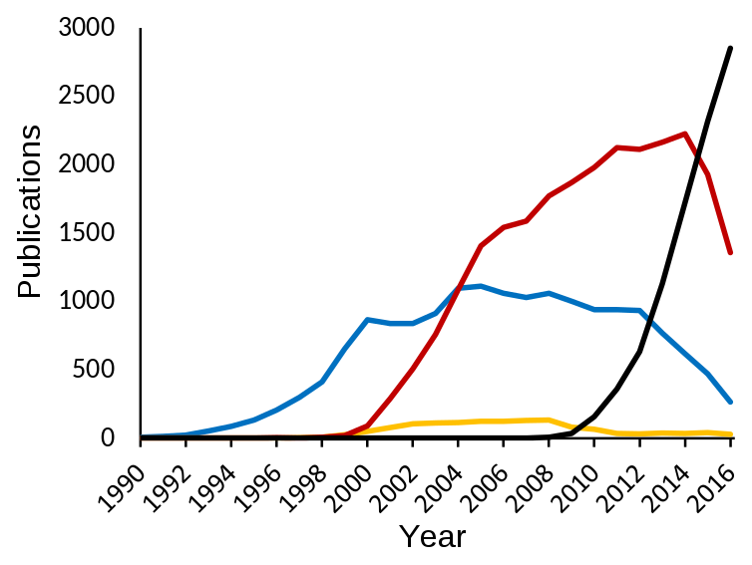
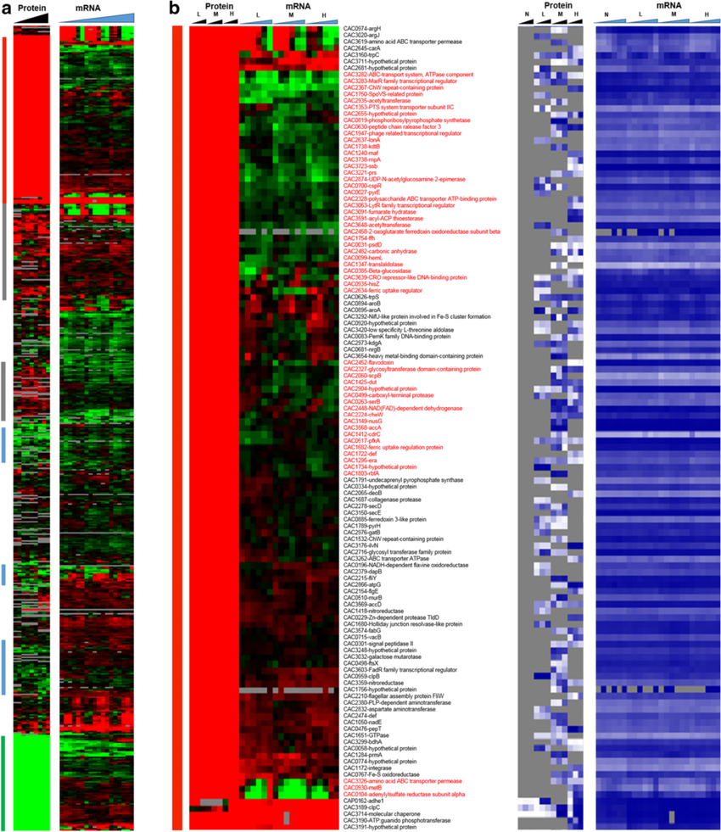
Background: Transcriptomics
Growth of publications with whole-transcriptome datasets available over time. RNA-Seq (black), RNA microarray (red), expressed sequence tag (blue) and serial/cap analysis of gene expression (yellow
Whole-transcriptomic data continues to rapidly accumulate.
Whole-transcriptome study results usually include lists of differentially expressed genes.
However, identifying specific targetable mechanisms of action by directly measuring cell signaling network activity is less accurate and more expensive.

Slide 6
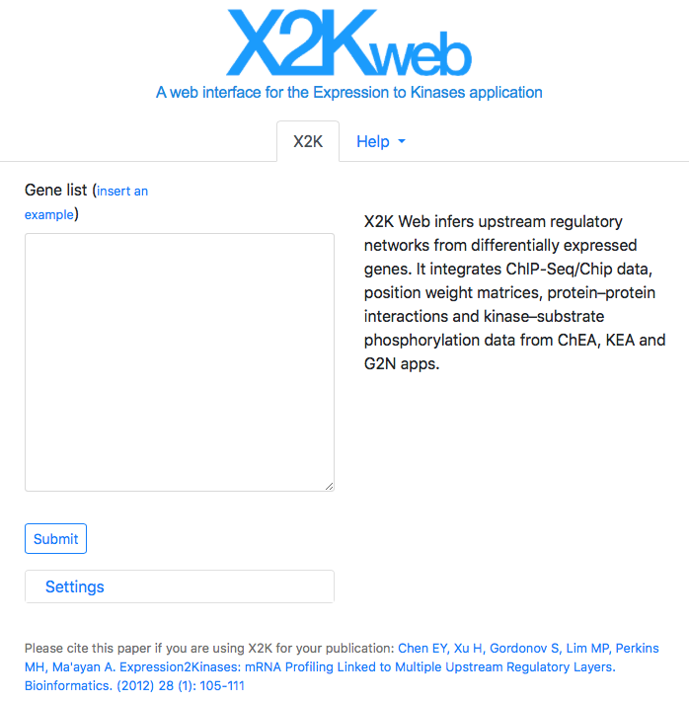
Expression 2 Kinases (X2K)
Function:
X2K takes a user-supplied list of genes (e.g. differentially expressed genes) and predicts targetable kinase mechanisms that underlie the phenotypes explored in transcriptomic studies (e.g. diseases, drugs).
Available as desktop, web and command line –based tools.

Slide 7
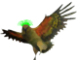
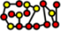
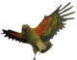
X2K Pipeline
Gene list
NSUN3
POLRMT
NLRX1
SFXN5
…
Kinases
NSUN3
POLRMT
NLRX1
SFXN5
…
TF-
enrichment
ChEA (ChIP Enrichment Analysis)
PPI
Network Construction
G2N (Genes 2 Networks)
Kinase-
enrichment
KEA (Kinase Enrichment Analysis)
Parameter | Examples | # Opts
TF Sort | P-value Rank Odds Ratio Combined Score | 4
Species | Human Mouse Both | 3
TF Databases | ChEA Transfac Both | 3
Background | Human-ARCHS4 Mouse-ARCHS4 hg133 | 3
Top TFs | 5 10 20 | 3
Parameter | Examples | # Opts
PPI Databases | BioGRID BioPLEX MINT | 18
PPI Path Length | 1 2 | 2
Parameter | Examples | # Opts
Kinase Sort | P-value Rank Odds Ratio Combined Score | 4
Kinase Background | Human-ARCHS4 Mouse-ARCHS4 hg133 | 3
Kinase Databases | KEA iPTMnet | 2
Top Kinases | Held constant at 20 | 1

Slide 8
X2K Pipeline
Gene list
NSUN3
POLRMT
NLRX1
SFXN5
…
Kinases
NSUN3
POLRMT
NLRX1
SFXN5
…
TF-
Enrichment
ChEA (ChIP Enrichment Analysis)
PPI
Network Construction
G2N (Genes2Networks)
Kinase-
Enrichment
KEA (Kinase Enrichment Analysis)
Parameter | Examples | # Opts
TF Sort | P-value Rank Odds Ratio Combined Score | 4
Species | Human Mouse Both | 3
TF Databases | ChEA Transfac Both | 3
Top TFs | 5 10 20 | 3
Parameter | Examples | # Opts
PPI Databases | BIND, BIOCARTA, BIOGRID, DIP, FIGEYS, HPRD, INNATEDB, INTACT, KEGG, MINT, MIPS, MURPHY, PDZBASE, PPID, PREDICEDPPI, SNAVI, STELZL, VIDAL, and HUMAP | 18
PPI Path Length | 1 2 | 2
Parameter | Examples | # Opts
Kinase Sort | P-value Rank Odds Ratio Combined Score | 4
Kinase Interactome | P KP | 2
Top Kinases | Held constant at 20 | 1

Slide 9
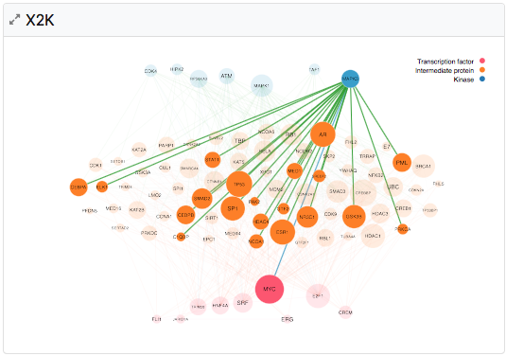
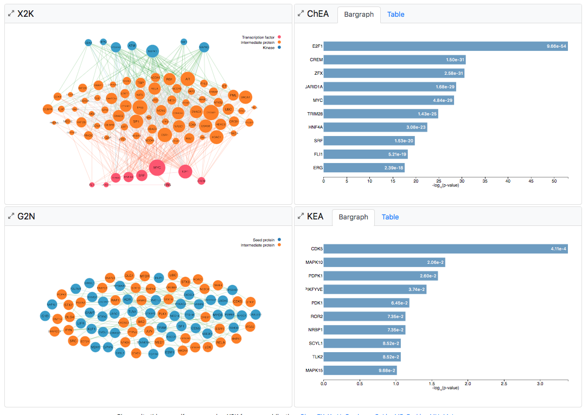
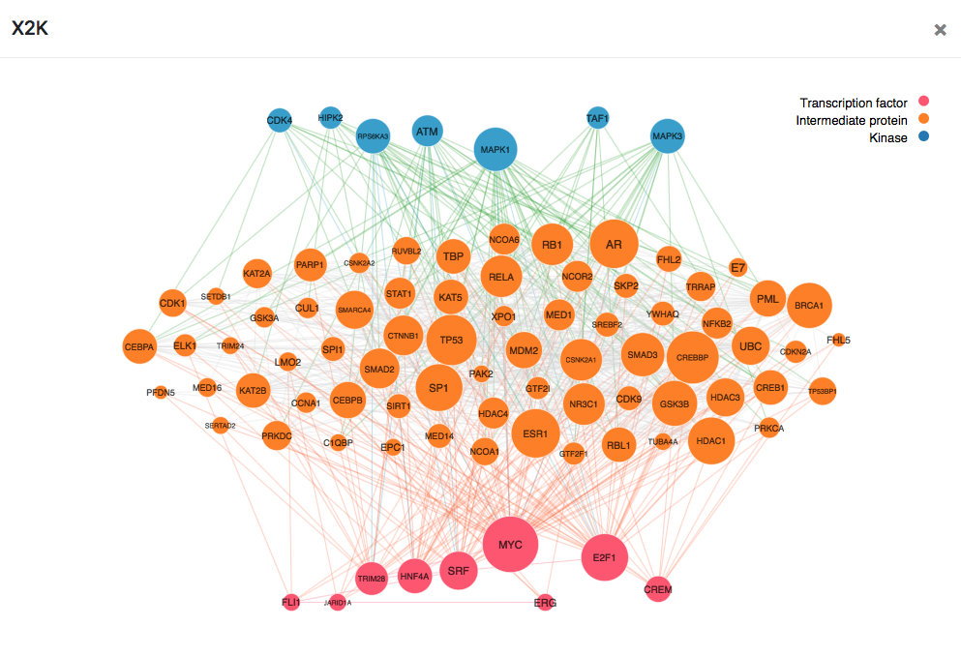
x2K Output
Kinases (from KEA)
PPI network (from G2N)
Transcription Factors (from ChEA)

Slide 10
Objectives
Test whether X2K can consistently recover kinases from kinase perturbation experiment data
Identify which parameters produce the best results (most commonly predict the target kinase)

Slide 11
Methods

Slide 12
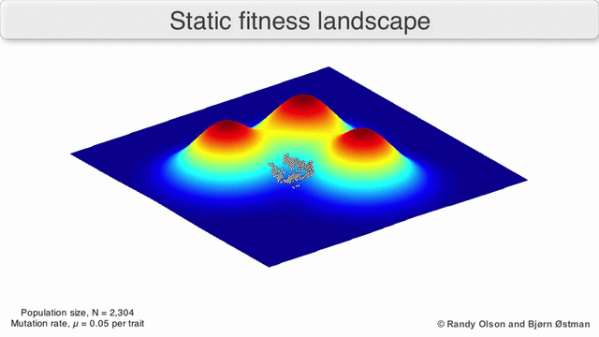

Genetic Algorithms (GA)
Efficiently identify the best combination of parameters (coded as binary strings) by searching the fitness landscape
Create population => select the fittest => breed a new population => random mutations => Repeat
Barry?....
Barry?!?!?!
Fitness
Genotype space
Genotype space

Slide 13
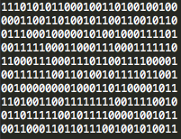
X2K Genetic Algorithm
Random Initial Population
Steps
Create random initial population of parameter combinations
Run X2K pipeline on population
Calculates fitness
Select fittest individuals and breed new generation
Introduce random mutations to prevent getting stuck at sub-optimal answer
Settings
Generations: 50
Population Size: 100/generation
Crossover points: 4
Random mutation rate: 0.01
1. Population
2. Run X2K pipeline to get kinase predictions
3. Calculate fitness
4. Breed fittest to get new population
5. Introduce random mutations
Repeat until average fitness reaches maximum

Slide 14
X2K Genetic Algorithm
Random Initial Population
Steps
Create random initial population of parameter combinations
Run X2K pipeline on population
Calculates fitness
Select fittest individuals and breed new generation
Introduce random mutations to prevent getting stuck at sub-optimal answer
Settings
Generations: 50
Population Size: 100/generation
Crossover points: 4
Random mutation rate: 0.01
1. Population
2. Run X2K pipeline to get kinase predictions
3. Calculate fitness
4. Breed fittest to get new population
5. Introduce random mutations
4. Select fittest individuals
Repeat until average fitness reaches maximum

Slide 15
X2K: Assessing fitness
How to determine which parameters combinations are best at recovering kinase targets?
Validation Datasets:
Gene Expression Omnibus (GEO): Kinase perturbation experiments (n=259).
LINCS L1000: Kinase-inhibitor drug perturbation experiments with(n=XXXX).
iPTMnet: Kinase perturbation experiments (n=XXXX).
KinomeScan: Kinase perturbation experiments (n=XXX).
Fitness function:
The % of experiments in which the known perturbed kinase was recovered, weighted by the perturbed kinase’s ranking in the significance-ordered output

Slide 16
Results

Slide 17
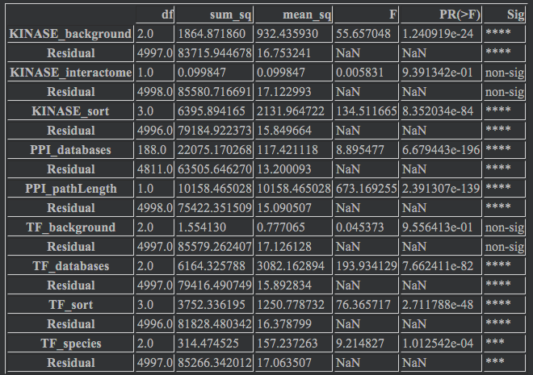
Results
I. GEO Validation Data
Results:
Stabilized after ~5 generations
Average fitness stabilized at ~22%
Peak fitness = 24.81% of kinases recovered
Average PPI size = 477 proteins
All parameters except Kinase_interactome and TF_background has a significant impact on fitness.

Slide 18
Results
II. iPTMnet Validation Data
Results:
Stabilized after ~5 generations
Average fitness stabilized at ~22%
Peak fitness = 24.81% of kinases recovered
Average PPI size = 477 proteins
PLACE HOLDER SLIDE

Slide 19
Results
III. LINCS L1000 Chem Validation Data
Results:
Stabilized after ~5 generations
Average fitness stabilized at ~22%
Peak fitness = 24.81% of kinases recovered
Average PPI size = 477 proteins
PLACE HOLDER SLIDE

Slide 20
Results
IV. LINCS KinomeScan Validation Data
Results:
Stabilized after ~5 generations
Average fitness stabilized at ~22%
Peak fitness = 24.81% of kinases recovered
Average PPI size = 477 proteins
PLACE HOLDER SLIDE

Slide 21
Optimized X2k Parameters
TF-
enrichment
ChEA (ChIP Enrichment Analysis)
PPI
Network Construction
G2N (Genes 2 Networks)
Kinase-
enrichment
KEA (Kinase Enrichment Analysis)
Parameter | Optimized Choices
TF Sort | Odds Ratio
Species | Human
TF Databases | Transfac
Background | Mouse-ARCHS3
Top TFs | 20
Parameter | Optimized Choices
PPI Databases | BIOCARTA FIGEYS HPRD INNATEDB
PPI Path Length | 1
Parameter | Optimized Choices
Kinase Sort | Combined score
Kinase background | Mouse-ARCHS4
Kinase Interactome | P
Top Kinases | Held constant at 20

Slide 22
Optimized X2k Parameters
TF-
Enrichment
ChEA (ChIP Enrichment Analysis)
PPI
Network Construction
G2N (Genes2Networks)
Kinase-
Enrichment
KEA (Kinase Enrichment Analysis)
Parameter | Optimized Choices
TF Sort | [ Inconsistent ]
Species | [ Inconsistent ]
TF Databases | Transfac
Top TFs | [ Inconsistent ]
Parameter | Optimized Choices
PPI Databases | BIOCARTA KEGG MIPS PPID
PPI Path Length | 2
Parameter | Optimized Choices
Kinase Sort | [ Inconsistent ]
Kinase Interactome | P

Slide 23
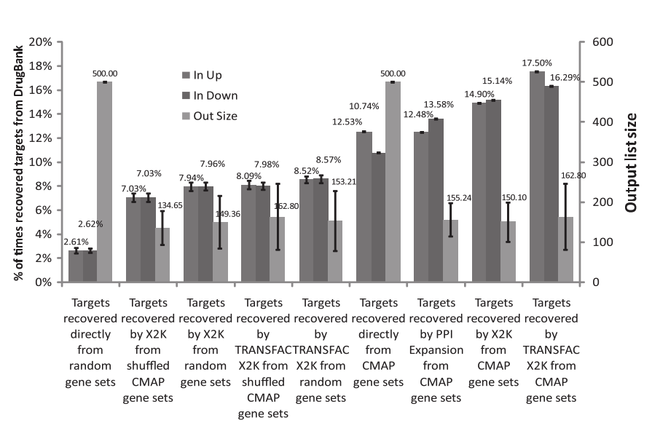
Comparison to chance
Chances of recovering kinase at random in KEA output:
20 kinases in KEA output / 473 kinases in KEA database = 4.22%
X2K performance with GA-optimized parameters = ~25%
Previous X2K results (Chen & Ma’ayan, 2012) recovered kinases in15-17% of cases
Insights as to why this is the case
Previous X2K performance
(Chen et. Al, 2012)

Slide 24
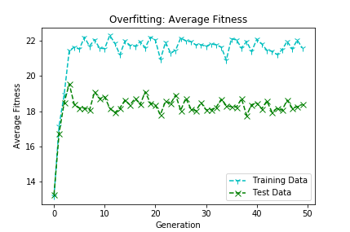
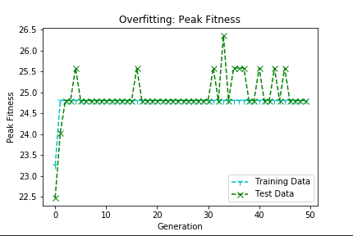
Overfitting tests
The GA was trained on only the first half of gene perturbation experiments (n=130)
Fitness was calculated using both the first half of the experiments and gain using the second half of the experiments (n=129)
While there were similar patterns of increasing fitness over generations, the Training and Test data did differ significantly on this run (p<0.001).
In it’s current state, the GA-optimized X2K pipeline performance doesn't translate extremely well across datasets, but is still capable of recovering kinases at levels well above chance levels.

Slide 25
Discussion
Parameter optimization results that were consistent across validation datasets:
Rank:
More sophisticated results-ordering methods (e.g. combined score, odds ratio) outperformed simpler metrics like raw p-value and rank.
Databases:
The optimization of X2K via GA identifies the following databases as relatively optimal for recovering mechanisms of action underlying differential gene expression:
TF-enrichment: 1, 2, 3
PPI construction: 1, 2, 3
Kinase-enrichment: 1, 2, 3
Potential Confounds:
X2K is biased towards large PPI networks.
However, the average PPI size after the GA stabilized was 477 protein, which is not unreasonably large. Also, the GA chose a PPI path length of 1 (not 2 which would have resulted in a much larger network).

Slide 26
Conclusions
X2K can recover kinases at levels (~25%) well above chance.
Potentially greater rates of kinase recovery can be achieved by adding additional quality databases.
X2K is an efficient and unbiased method of identifying upstream regulatory kinase mechanisms that can potentially targeted in therapeutic contexts

Slide 27
Future Directions
Use kinase rank-weighted fitness score
Add more databases/methods
TF-
enrichment
ChEA (ChIP Enrichment Analysis)
PPI
Network Construction
G2N (Genes 2 Networks)
Kinase-
enrichment
KEA (Kinase Enrichment Analysis)
Parameter | Additions
TF Databases | ARCHS4 human TF
 | ARCHS4 mouse TF
 | ENCODE 2016
 | Crowd TF
 | huMAP TF
 | BioGRID low throughput TF
 | CREEDS-TF
Parameter | Additions
PPI Databases | BioPlex
 | iREF
Parameter | Additions
Kinase Databases | CREEDS Kinases
 | PhosphoSitePlus
 | NetworkKlN
 | iPTMnet
 | L1000 Kinases

Slide 28
References
Acknowledgements
Stuhlmiller, T. J., Miller, S. M., Zawistowski, J. S., Nakamura, K., Beltran, A. S., Duncan, J. S., … Johnson, G. L. (2015). Inhibition of lapatinib-induced kinome reprogramming in ERBB2-positive breast cancer by targeting BET family bromodomains. Cell Reports, 11(3), 390–404. https://doi.org/10.1016/j.celrep.2015.03.037
Duncan, J. S., Whittle, M. C., Nakamura, K., Abell, A. N., Midland, A. A., Zawistowski, J. S., … Johnson, G. L. (2012). Dynamic reprogramming of the kinome in response to targeted MEK inhibition in triple-negative breast cancer. Cell, 149(2), 307–321. https://doi.org/10.1016/j.cell.2012.02.053
Chen, E. Y., Xu, H., Gordonov, S., Lim, M. P., Perkins, M. H., & Ma’ayan, A. (2012). Expression2Kinases: mRNA profiling linked to multiple upstream regulatory layers. Bioinformatics, 28(1), 105–111. https://doi.org/10.1093/bioinformatics/btr625
Ma’ayan Lab members
Funding
Contact Information
Brian Schilder
brian.schilder@mssm.edu

